Slide 1
5.2Risk-Neutral Measure
Part 2
報告者：陳政岳

Slide 2
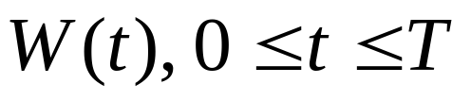

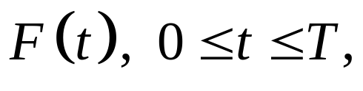
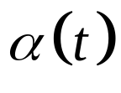
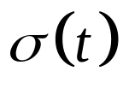
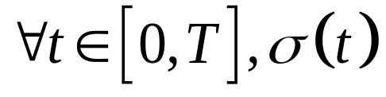
5.2.2 Stock Under the Risk-Neutral Measure
is a Brownian motion on a probability space , and is a filtration for this Brownian motion. T is a fixed final time.
A stock price process whose differential is
where :the mean rate of return and
:the volatility are adapted processes.
Assume that, is almost surely not zero.

Slide 3
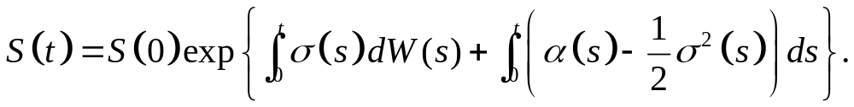
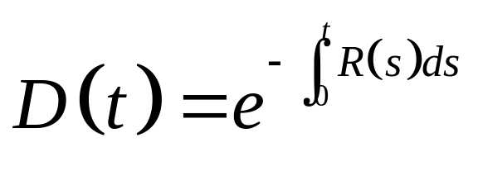
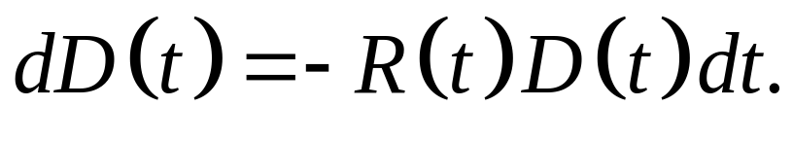
The stock price is a generalized Brown motion (see Example 4.4.8), and an equivalent way of writhing is
Supposed we have an adapted interest rate process R(t). We define the discount process
and

Slide 4
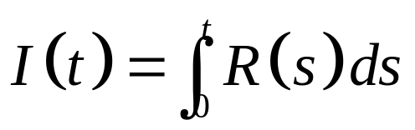
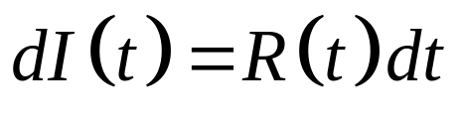
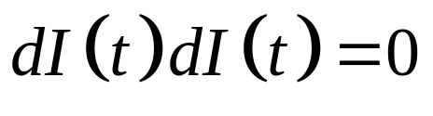
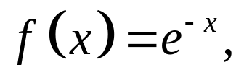
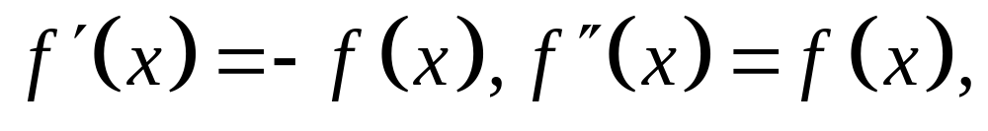
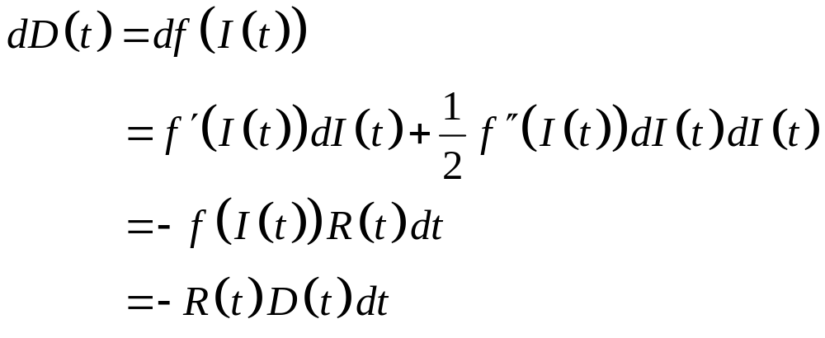
Define so that and .
First, we introduction the function for which and use the Ito-Doeblin formula to write

Slide 5

Although D(t) is random, it has zero quadratic variation. This is because it is “smooth.” Namely, one does not need stochastic calculus to do this computation.
The stock price S(t) is random and has nonzero quadratic variation. If we invest in the stock, we have no way of knowing whether the next move of the driving Brownian motion will be up or down, and this move directly affects the stock price.

Slide 6
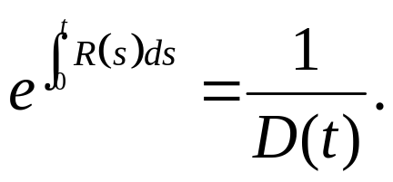
Considering a money market account with variable interest rate R(t), where money is rolled over at this interest rate. If the price of a share of this money market account at time zero is 1, then the price of a share of this money market account at time t is

Slide 7
If we invest in this account, over short period of time we know the interest rate at the time of the investment and have a high degree of certainty about what the return.
Over longer periods, we are less certain because the interest rate is variable, and at the time of investment, we do not know the future interest rates that will be applied.
The randomness in the model affect the money market account only indirectly by affecting the interest.

Slide 8
Changes in the interest rate do not affect the money market account instantaneously but only when they act over time.( Warning: . For a bond, a change in the interest rate can have an instantaneous effect on price.)
Unlike the price of the money market account, the stock price is susceptible to instantaneous unpredictable changes and is, in this sense, “more random” than D(t). Because S(t) has nonzero quadratic variation, D(t) has zero quadratic variation.

Slide 9
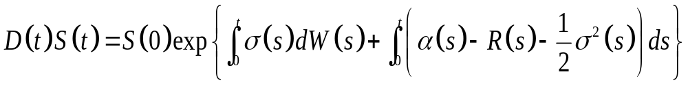
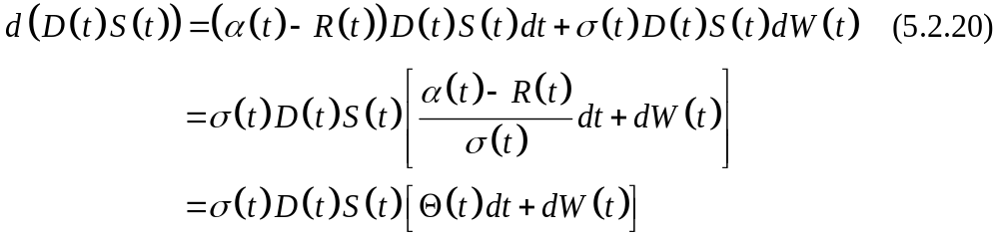
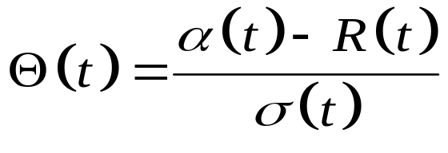
The discounted stock price process is
(5.2.19) and its differential is
where we define the market price of risk to be

Slide 10
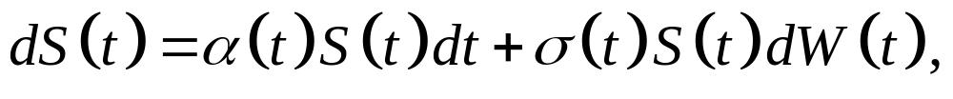
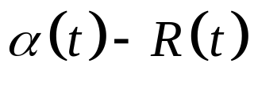
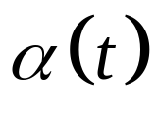
(5.2.20) can derive either by applying the Ito-Doblin formula or by using Ito product rule.
The first line of (5.2.20), compare with
shows that the mean rate of return of the discounted stock price is , which is the mean rate of the undiscounted stock price, reduced by the interest rate R(t).
The volatility of the discounted stock price is the same as the volatility of the undiscounted stock price.

Slide 11

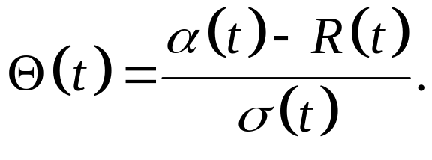
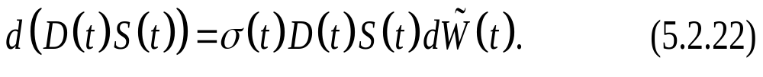
The probability measure defined in Girsanov’s Theorem, Theorem 5.2.3, which uses the market price of risk
In terms of the Brownian motion of that theorem, we rewrite (5.2.20) as
We call , the measure defined in Girsanov’s Theorem, the risk-neutral measure because it is equivalent to the original measure P

Slide 12
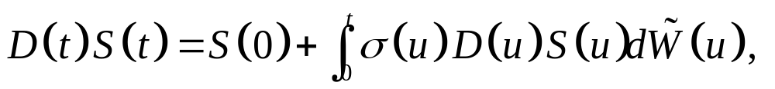
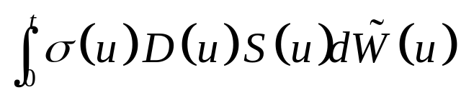
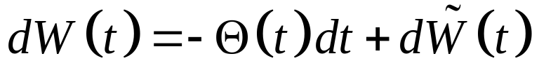
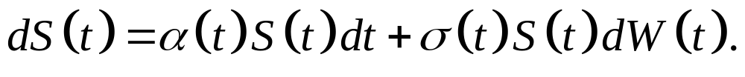
According to (5.2.22),
and under the process is an Ito-integral and is a martingale.
The undiscounted stock price S(t) has mean rate of return equal to the interest rate under , as one can verify by making the replacement in

Slide 13
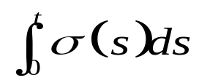
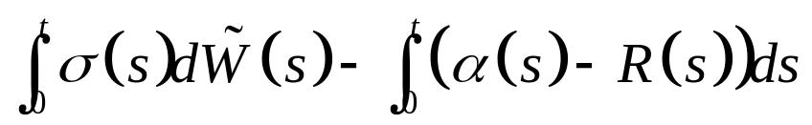
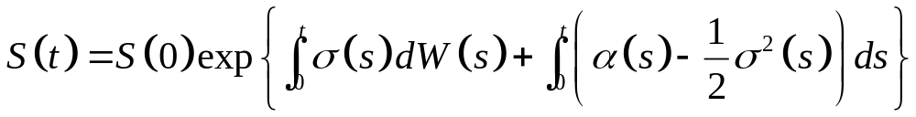
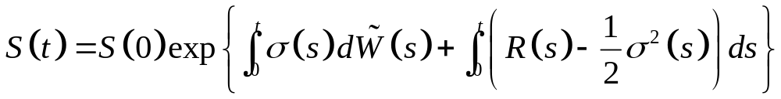
We can solve this equation for S(t) by simply replacing the Ito integral by its equivalent in
to obtain the formula

Slide 14
In discrete time: the change of measure does not change the binomial tree, only the probabilities on the branches of the tree.
In continuous time, the change from the actual measure P to the risk-neutral measure change the mean rate of return of the stock but not the volatility.

Slide 15
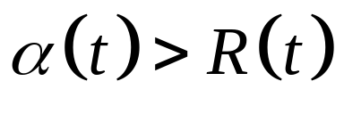
After the change of measure , we are still considering the same set of stock price paths, but we shifted the probability on them.
If , the change of measure puts more probability on the paths with lower return so return so that the overall mean rate of return is reduced from to R(t)

Slide 16
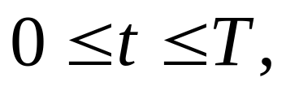
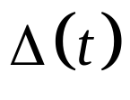
5.2.3 Value of Portfolio Process Under the Risk-Neutral Measure
Initial capital X(0) and at each time t, holds shares of stock, investing or borrowing at the R(t).
The differential of this portfolio value is given by the analogue of (4.5.2)

Slide 17
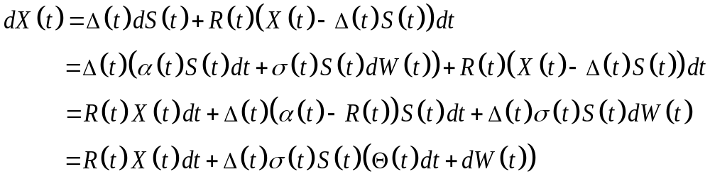
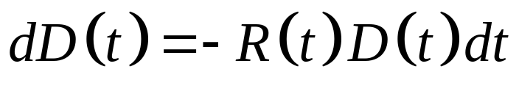
5.2.3 Value of Portfolio Process Under the Risk-Neutral Measure
By Ito product rule, (5.2.18) and
(5.2.20) imply

Slide 18
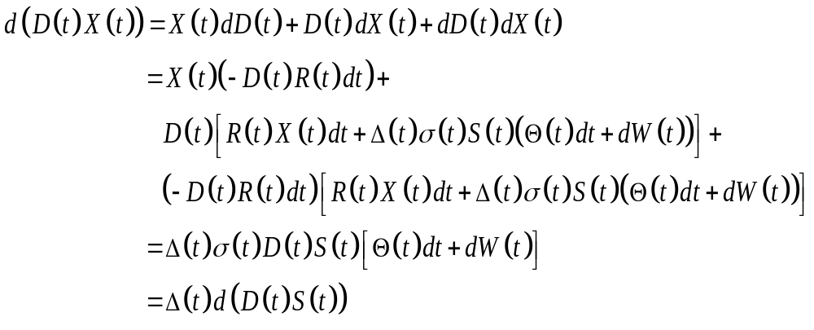
5.2.3 Value of Portfolio Process Under the Risk-Neutral Measure

Slide 19
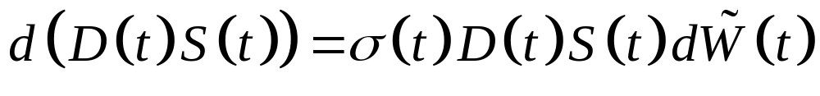
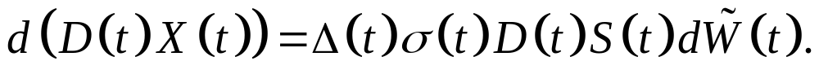
5.2.3 Value of Portfolio Process Under the Risk-Neutral Measure
Changes in the discounted value of an agent’s portfolio are entirely due to fluctuations in the discounted stock price. We may use
(5.2.22)to rewrite as

Slide 20

5.2.3 Value of Portfolio Process Under the Risk-Neutral Measure
We has two investment options:
(1) a money market account with rate of return R(t),
(2) a stock with mean rate of return R(t) under
Regardless of how the agent invests, the mean rate of return for his portfolio will be R(t) under P, and the discounted value of his portfolio, D(t)X(t), will be a martingale.

Slide 21

5.2.4 Pricing Under the Risk-Neutral Measure
In Section 4.5, Black-Scholes-Merton equation for the value the European call have initial capital X(0) and portfolio process an agent would need in order hedge a short position in the call.
In this section, we generalize the question.

Slide 22
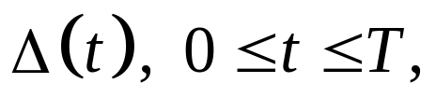
5.2.4 Pricing Under the Risk-Neutral Measure
Let V(T) be an F(T)-measurable random variable. This payoff is path-dependent which is F(T)-measurability.
Initial capital X(0) and portfolio process
we wish to know that an agent would need in order to hedge a short position, i.e., in order to have
X(T) = V(T) almost surely.
We shall see in the next section that this can be done.

Slide 23
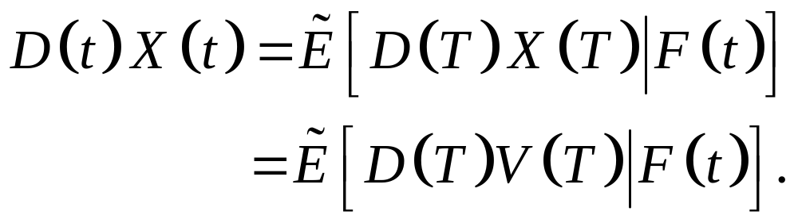
5.2.4 Pricing Under the Risk-Neutral Measure
In section 4.5, the mean rate of return, volatility, and interest rate were constant.
In this section, we do not assume a constant mean rate of return, volatility, and interest rate.
D(T)X(T) is a martingale under implies

Slide 24
5.2.4 Pricing Under the Risk-Neutral Measure
The value X(t) of the hedging portfolio is the capital needed at time t in order to complete the hedge of the short position in the derivative security with payoff V(T).
We call the price V(t) of the derivative security at time t, and the continuous-time of the risk-neutral pricing formula is

Slide 25
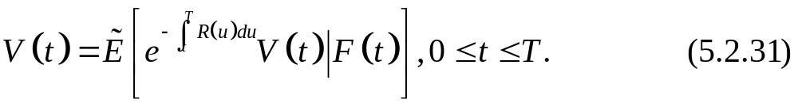
5.2.4 Pricing Under the Risk-Neutral Measure
Dividing (5.2.30) by D(t), which is F(t)-measurable. We may write (5.2.30) as
We shall refer to both (5.2.30) and (5.2.31) as the risk-neutral pricing formula for the continuous-time model.

Slide 26
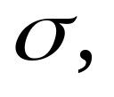
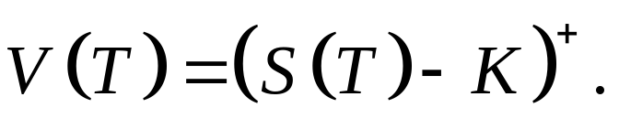
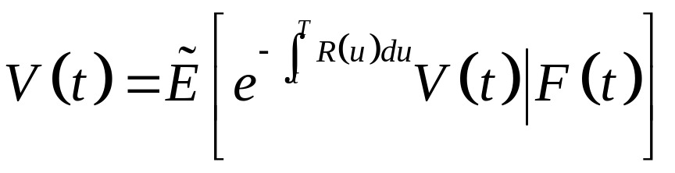
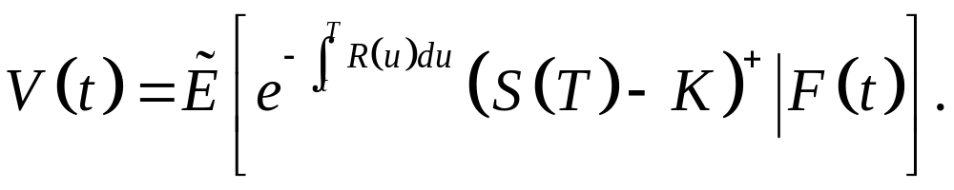
5.2.5 Deriving the Black-Scholes-Merton Formula
To obtain the Black-Scholes-Merton price of a European call, we assume constant volatility constant interest rate r, and take the derivative security payoff to be
The right-hand side of
becomes

Slide 27
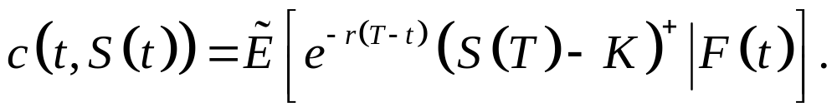
5.2.5 Deriving the Black-Scholes-Merton Formula
Because geometric Brownian motion is a Markov process, this expression depends on the stock price S(t) and on the time t at which the conditional expectation is computed, but not on the stock price prior to time t.
There is a function c(t,x) such that

Slide 28
5.2.5 Deriving the Black-Scholes-Merton Formula
Computing c(t,x) using the Independence Lemma, Lemma 2.3.4.

Slide 29
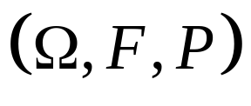

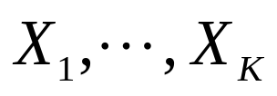
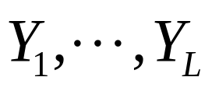




Lemma 2.3.4 (Independence)
Let be a probability space, and let G be a sub- -algebra of F. Suppose the random variables are G-measurable and the random variables are independent of G. Let be a function of the dummy variables and and define
Then

Slide 30



5.2.5 Deriving the Black-Scholes-Merton Formula
With constant and r, equation
becomes
and then rewrite

Slide 31


where Y is the standard normal random
variable , and is the “time
to expiration” T-t.
S(T) is the product of the F(t)-measurable random variable S(t) and the random variablewhich is independent of F(t).

Slide 32

Therefore,

Slide 33


5.2.5 Deriving the Black-Scholes-Merton Formula
The integrand
is positive if and only if

Slide 34

5.2.5 Deriving the Black-Scholes-Merton Formula
Therefore,

Slide 35


5.2.5 Deriving the Black-Scholes-Merton Formula
where
So, the notation
where Y is a standard normal random variable under

Slide 36

5.2.5 Deriving the Black-Scholes-Merton Formula
We have shown that
Here we have derived the solution by device of switching to the risk-neutral measure.

